Slide 1
Online bus pass generator
Make as you go!!

Slide 2
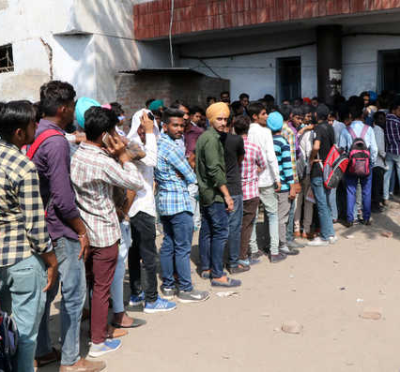
What make this idea a realistic word?
The biggest problem is this, the long queues of students .
They are here just to make or renew there existing passes by missing there lectures and wasting there precious time.

Slide 3
Key points!!
What it is actually??
To create a hassle free procedure for the student electronically when the students demand the bus pass the online portal would facilitate all the people involved in this contrast to have a brake and utilize there energies in the useful way without making an extra effort of missing there syllabus and standing in long lines no matter the whether conditions or the students mental or physical conditions .with doing all this process online, the students will not miss their classes and also the bus cooperation officials will not have to write all the details of the students on the bus pass and even on there personal registers just to maintain there their records . this technique also have a future scope, This technology can later be expanded to generate the bus pass for normal person (who are not students), even other bus cooperation of India can take advantage of this system and as this system prevents wastage of paper, further it can be expended to generate a online railway pass for students as well as for normal people, it puts a step forward towards a corruption free India.
Time savor.
Online transactions make it user friendly.
Eco-friendly system.
Less burden on administration and co-operation officials
Has future scopes!!

Slide 4
What is the advantage of this online portal!!
Existing technology
INNOVATION Used
The process of making the bus pass is a hectic work which is put on the shoulders of the college students.
They have to line up in long queues in order to make /renew their bus passes which is time consuming
There is a bottle neck situation, only one or two official sitting on the seat to renew or to make a new pass which even pressurizes the officer to work in a hustle which intern lead to various mistakes and even unnecessary wastage of paper and various useful resources
We need to establish an online bus pass making /renew system which would save students time as well as the time of officials in making that whole procedure by hand.
Digital, for making the new pass the system would verify the student’s credentials and issue them a new copy of bus pass, which make it more secure than the existing technology.
On the other hand, for renewing the pass the system would take the entries and the approvals from the concerned institutions

Slide 5
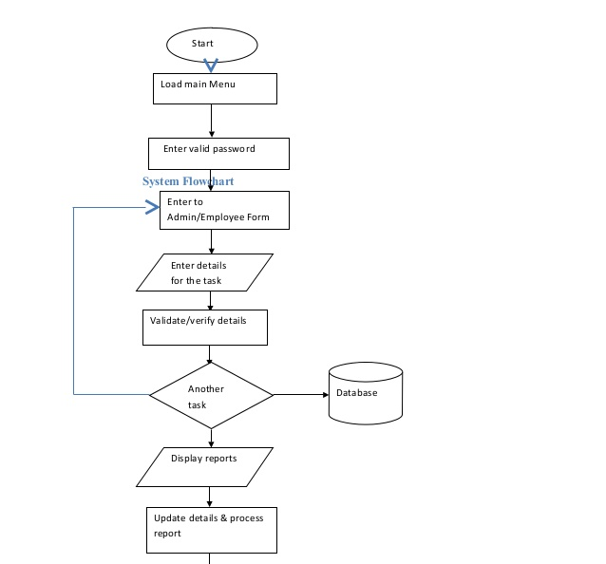
How the work flows in this
The easiest and the simplest way to generate the pass. Solving the problem of hassle free situations of making passes
Exit

Slide 6

The question arises is it cheaper?
Yes, it’s cheaper. normally to make pass we have to give bribe to the concerned person
Rs.10 then Rs.1000 is the extra income of that officer which is even counted as black money
Deploying an online system would help in transpiercing the procedure and the transfer of money from one end to the other

Slide 7
Key aspects!!
Electronic
Saving student’s time.
Online transactions.
User friendly
Eco-friendly

Slide 8
Thankyou!!

Slide 9
Author: kamaalpreet singh
Collage: Chandigarh group of collages collage of engineering, Landran, Mohali, Punjab

